Slide 1
02. virtualization

Slide 2
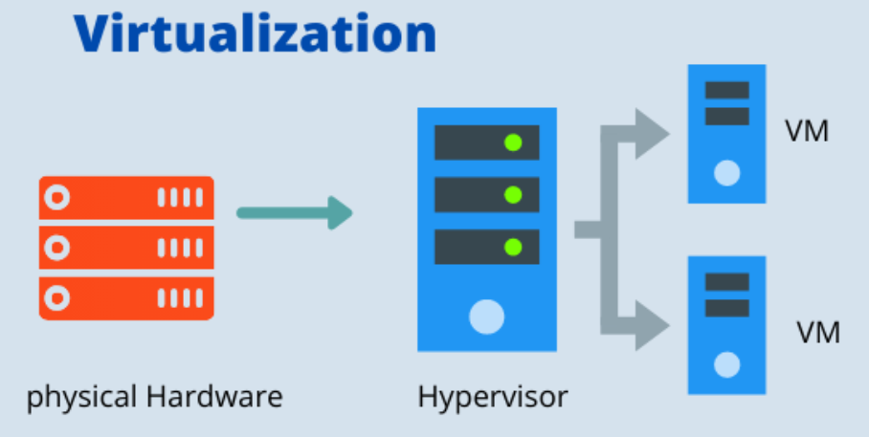
2.1 introduction of virtualization : -
A technology that you can use to create virtual representations of servers, storage, networks and other physical machines is called Virtualization.
Virtual software mimics the functions of physical hardware to run multiple virtual machines simultaneously on a singles physical machine.
Virtualization uses a software to create an abstraction layer over computer hardware that allows the hardware elements of a single computer to be divided into multiple virtual computers, commonly called virtual machines (VMS).
Each VM runs it's own operating system and behaves like an independent computer, even though it is runing on just a portion of the actual underlying computer hardware..

Slide 3
Characteristics of virtualized environment : -
1. Increased Security : - The ability to control the execution of a guest program in a completely transparent manner opens new possibilities for delivering a secure, controlled execution environment.
2. Sharing : - Virtualization allows the creation of a seperate computing environment on the same host. This basic feature is used to reduce the no. of active servers and limit power consumption.
3. Aggregation : - A group of seperate hosts can be tied together and represented to guests as a single virtual host. This funactionality is implemented with cluster management software, which harnesses the physical resources of a homogenous group of machines and represents them as a single resource.
4. Resource sharing : - Virtualization allows multiple virtual machines to share the resources of a single physical machine. such as CPU, memory, storage and network band width.
5. Flexibility : - Virtualization allow IT administrators to quickly and easily create, modify, or delete virtual machines as needed, without the need to purchase and configure additional physical hardware.
6. Scalability : - Virtualization allows organizations to scale their computing resources up or down as needed, depending on changing business requirements.

Slide 4
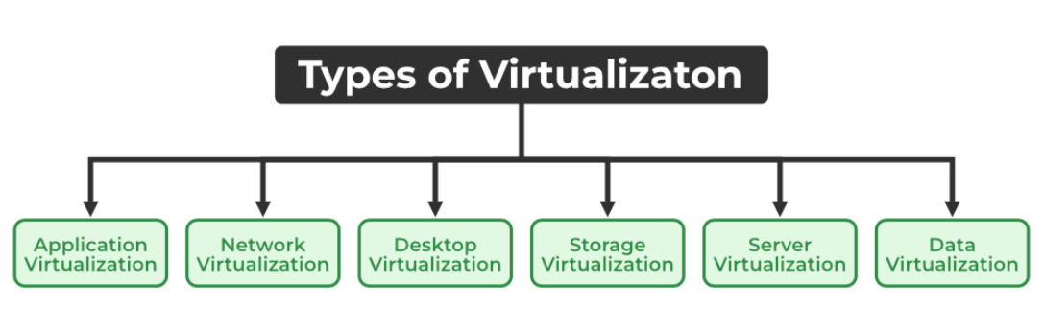
Types of virtualization : -

Slide 5
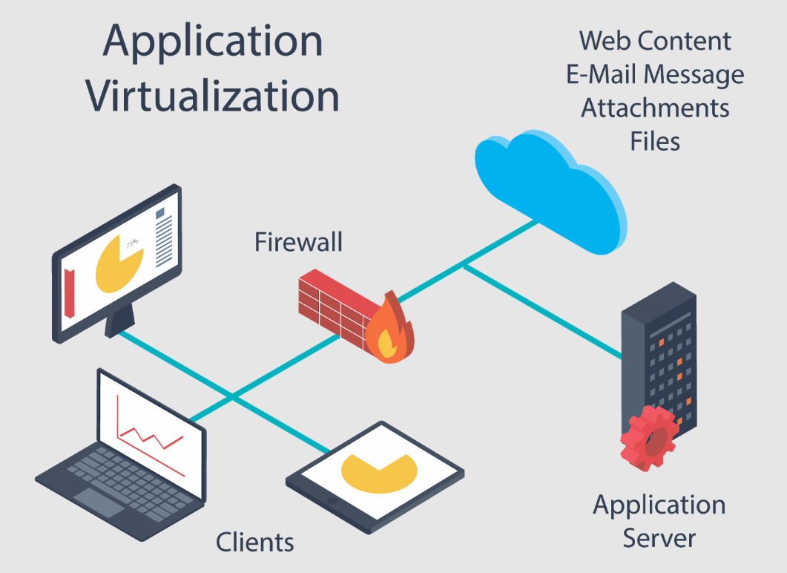
1. Application virtualization : -
Application Virtualization helps a user to have remote access to an application from a server.
The server stores all personal information & characteristics of the application but can still run on a local workstation through internet.
An example of this would be a user who needs to run two different versions of the same software.
Technologies that use Application Virtualization are Hosted and Packaged applications.

Slide 6
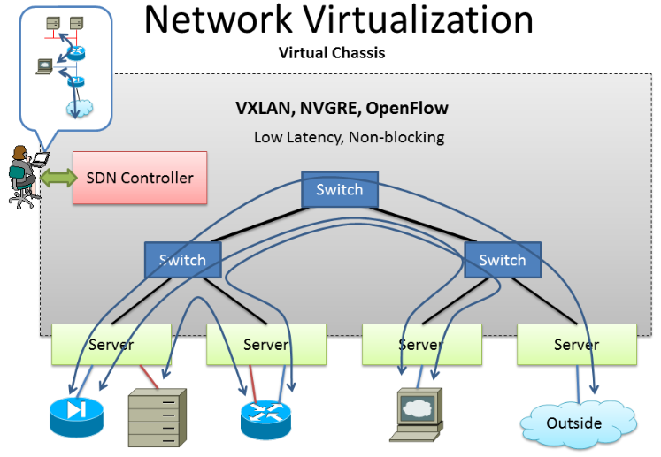
2. Network virtualization : -
Network Virtualization is the ability to run multiple virtual networks with each having a seperate control and data plan.
It co-exists together on top of one physical network.
It can be managed by individual parties that are potentially confidential to each other.
Network Virtualization provides a facility to create and provision virtual networks, logical switches, routers, firewalls, load balancers, Virtual Private Networks (VPN), and workload security within. days or even weeks.

Slide 7
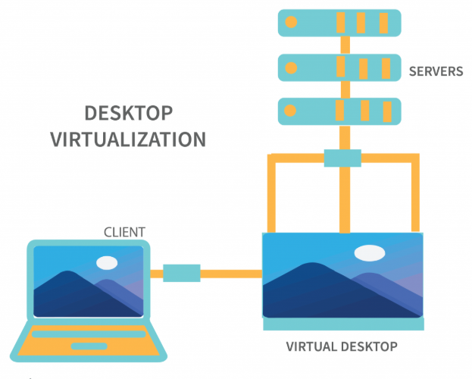
3. Desktop virtualization : -
Desktop Virtualization allow the users OS to be remotely stored on a server in the data center.
It allows the user to access their desktop virtually, from any location by a different machine.
Users who want specific operating systems other than windows server will need to have a virtual desktop.
The main benifits of desktop virtualization are user mobility, portability and easy management of software installation.

Slide 8
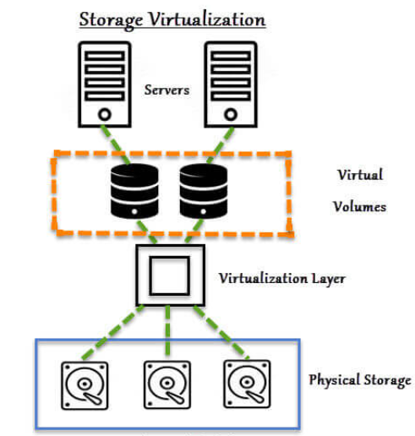
4. Storage virtualization : -
Storage Virtualization is an array of servers that are managed by a virtual storage system.
The Servers aren't aware of exactly where their data is stored and instead function more like worker bees in a hive.
It makes managing storage from multiple sources be manage and utilized as a single repository.
Storage Virtualization maintains smooth operations, consistent performance and a continuous suite of advanced functions.

Slide 9
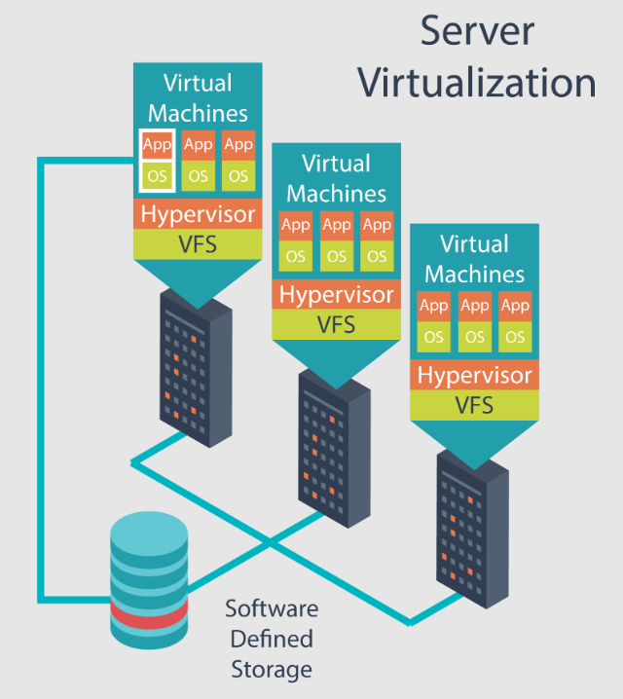
5. Server virtualization : -
In Server Virtualization the masking of server resources takes place.
Here, the central (Physical) server is divided into multiple different virtual servers by changing the identity number and processors.
So, each system can operate its OS in as isolated manner.
Where, each sub-server knows the identity of the central server.
It's beneficial in virtual migration, reducing energy consumption, reducing infrastructural costs, etc.

Slide 10
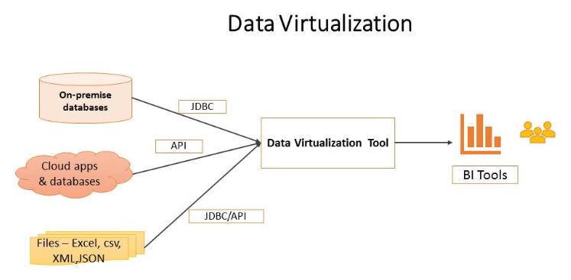
6. Data virtualization : -
In Data Virtualization the data is collected from various sources and managed at a single place without knowing more about the technical information.
Like how the data is collected, stored and formatted then arranged that data logically.
So that its virtual view can be accessed by its interested people and stakeholders, and users through the various cloud services remotely.
Many big giant companies are providing their services like Oracle, IBM, At scale, data, etc.

Slide 11
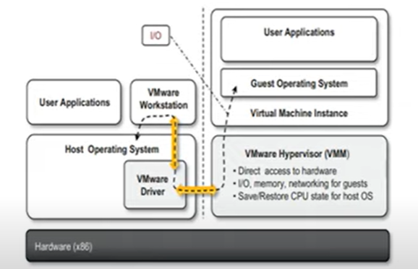
2.3 technology examples : -
VMWare : (Full Virtualization) : -
- VMware is based on the concept of full virtualization which involves duplicating the underlying hardware and presenting it to the guest OS.
- Full Virtualization allows multiple VM to run on a single physical host with different OS as Linux, Windows.
- VM Ware implements full virtualization either in the desktop environment by means of Type ll Hypervisors, or in the server environment by means of Type 1 Hypervisors.
- Besides these two core solutions, VMware provides additional tools and software that simplify the use of Virtualization.

Slide 12
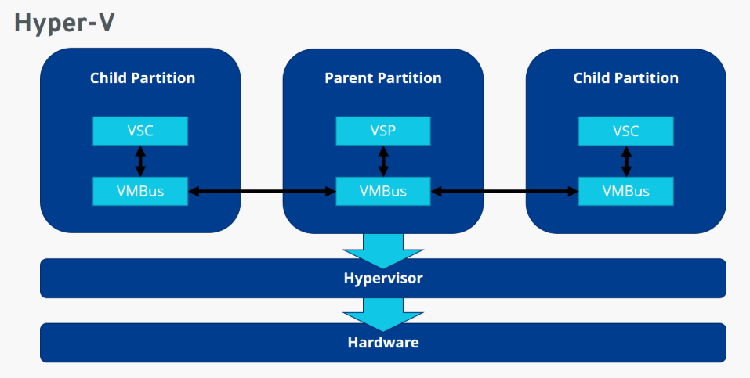
Microsoft hyper-v : -
Hyper-V is an Infrastructure virtualization solution developed by Microsoft for server virtualization.
It allows you to create and manage VMs on Windows-based servers.
Hyper-V is commonly used in data centers, enterprise environment and cloud services.
It uses a hypervisor-based approach to hardware virtualization.

Slide 13
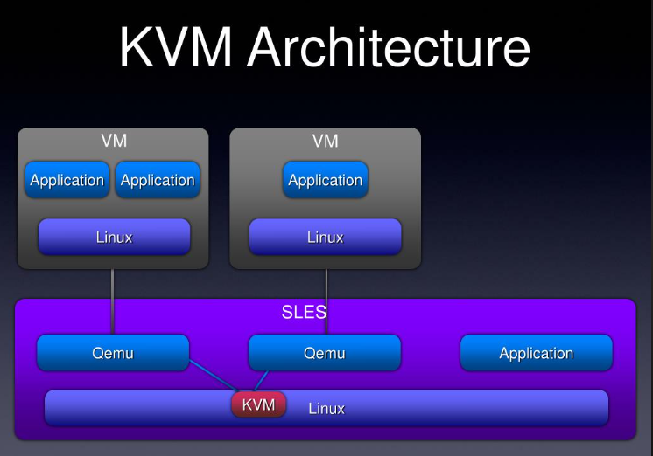
Kvm – based architecture : -
KVM is a Full virtualization solution in the Linux kernel, that allows the kernel to function as a Hypervisor.
KVM can turn any Linux Machine into a bare-metal hypervisor.
A normal linux processor has two modes of execution : kernal and user. KVM adds a third mode: Guest mode.
An IT department can use KVM to host multiple linux and windows server on single physical machine.

Slide 14
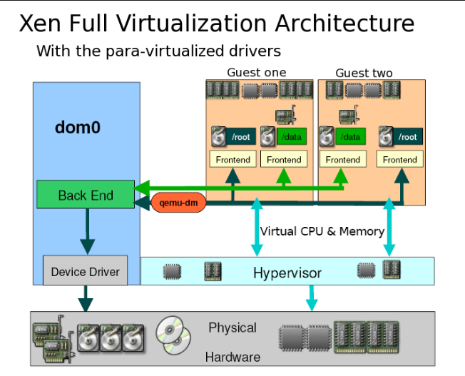
Xen (para-virtualization) : -
Xen is an open-source platform based on paravirtualization.
Initially developed at the University of Cambridge in UK.
Paravirtualization involves modifying the os running inside a VM to make it aware of its Virtualized environment.
Xen-based technology is used for either desktop virtualization or server virtualization.
It has also been used to provide cloud computing solutions by means of Xen cloud Platform (XCP)

Slide 15
2.4 Advantages of virtualization : -
1. Utilization of Hardware Efficiency : - With the help of Virtualization, Hardware is efficiently used by user as well as cloud Service provider.
2. High Availability : - One of the main benifit of virtualization is that it provides advance Features which allow virtual instances to be available all the times.
3. Disaster Recovery is efficient and easy : - In traditional method, if somehow due to some disaster if server system Damaged then the surety of Data Recovery is very less. But with the tools of virtualization, real time data backup recovery & mirroring become easy.
4. Saves Energy : - Virtualization will help to save energy because while moving from physical servers to virtual servers; the no. of servers decreases due to this montly power & cooling cost decreases which will save money as well.

Slide 16
Vm migration : -
Virtual Machine Migration is the process of moving a running virtual Machine from one physical hardware environment to another.
VM Migration is a valuable tool in cloud computing for migrating operating system instances across various physical machines.
Types of VM Migration : -
1. Live Migration : - The VM is moved while its still running ensuring no downtime used for tasks like maintenance, load balancing and disaster recovery.
2. Cold Migration : - The VM is shut down before being moved and can be used for less time-sensitive task or where shared storage isn't available.

Slide 17
Vm consolidation : -
Virtual Machine consolidation involves reducing the no. of active physical hosts by moving VMs onto fewer server, maximizing resource utilization & minimizing costs.
To fix the error 'Virtual Machine Consolidation Needed’, right-click on the virtual machine and select VM > snapshots → consolidate.
VM consolidation simplifies IT management by consolidating workloads onto fewer machines.
It also enables easier scaling of resources in response to demand.

Slide 18
Vm management : -
Virtual Machine management software communicates with virtual environment as well as the underlying physical hardware to ease resource administration, improve data analytics, and expedite operations.
Each VM Management system is unique, but most have an easy-to-use user interface, assign resources, create reports, and enforce policies automatically.

Slide 19
2.5 disadvantages of virtualization : -
1. High Cost Implementation : -
i) When considering virtualization, the average individual or corporation will incur relatively low costs.
ii) However, the implementation expenses for virtualized environment providers can be fairly significant.
2. Security Risks : -
i) Virtualizations opens the door to a capability of emulating a host in a completely transparent manner.
ii) Also malicious programs can preload themselves before the operating system.

Slide 20
3. External attack : -
i) Virtual machines can potentially be infected with viruses, spyware and ransomware.
ii) These attacks can be launched by infected VM images or by people who have not received adequate security training.
4. Performance Degradation : -
i) since virtualization interposes an abstraction layer between the guest and host, the guest can experience increased latencies.
ii) The causes of performance degradation can be traced back to the overhead by: Maintaining the status of Virtual processors, support priveleged instructions, support of paging within VM.

